Slide 1
Command Line Arguments in C
The arguments passed from command line are called command line arguments. These arguments are handled by main() function.
To support command line argument, you need to change the structure of main() function as given below.
int main(int argc, char *argv[] )
Here, argc counts the number of arguments. It counts the file name as the first argument.
The argv[] means the value of the argumes. contains the total number of arguments. The first argument is the file name always.

Slide 2
Example Let's see the example of command line arguments where we are passing one argument with file name.
#include <stdio.h>
void main(int argc, char *argv[] ) {
printf("Program name is: %s\n", argv[0]);
if(argc < 2){
printf("No argument passed through command line.\n");
}
else{
printf("First argument is: %s\n", argv[1]);
}
}

Slide 3
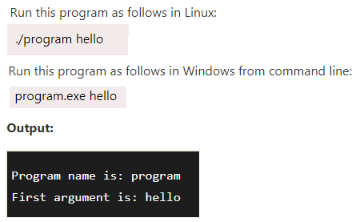

Slide 4
typedef in C
typedef is a keyword used in C language to assign alternative names to existing datatypes.Syntax of typedef
typedef <existing_name> <alias_name>
In the above syntax, 'existing_name' is the name of an already existing variable while 'alias name' is another name given to the existing variable.

Slide 5
For example..
typedef unsigned int unit;

Slide 6
Now, we can create the variables of type unsigned int by writing the following statement:
unit a, b;
instead of writing:
unsigned int a, b;

Slide 7
Example
#include <stdio.h>
int main()
{
typedef unsigned int unit;
unit i,j;
i=10;
j=20;
printf("Value of i is :%d",i);
printf("\nValue of j is :%d",j);
return 0;
}

Slide 8
Output
Value of i is :10
Value of j is :20

Slide 9
Using typedef with structures
Consider the below structure declaration:
struct student
{
char name[20];
int age;
};
struct student s1;
In the above structure declaration, we have created the variable of student type by writing the following statement:
struct student s1;

Slide 10
Usage of typedef in structure
struct student
{
char name[20];
int age;
};
typedef struct student stud;
stud s1, s2;
In the above statement, we have declared the variable stud of type struct student. Now, we can use the stud variable in a program to create the variables of type struct student.

Slide 11
Example
#include <stdio.h>
typedef struct student
{
char name[20];
int age;
}stud;
int main()
{
stud s1;
printf("Enter the details of student s1: ");
printf("\nEnter the name of the student:");
scanf("%s",&s1.name);
printf("\nEnter the age of student:");
scanf("%d",&s1.age);
printf("\n Name of the student is : %s", s1.name);
printf("\n Age of the student is : %d", s1.age);
return 0;
}

Slide 12
Using typedef with pointers
We can also provide another name or alias name to the pointer variables with the help of the typedef.
For example, we normally declare a pointer, as shown below:
int* ptr;
We can rename the above pointer variable as given below:
typedef int* ptr;
In the above statement, we have declared the variable of type int*. Now, we can create the variable of type int* by simply using the 'ptr' variable as shown in the below statement:
ptr p1, p2 ;

Slide 13
Const pointer
Double pointer

Slide 14
https://www.jdoodle.com/c-online-compiler/

